Slide 1

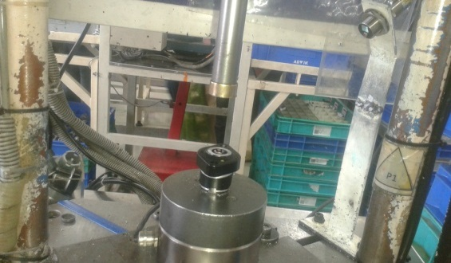
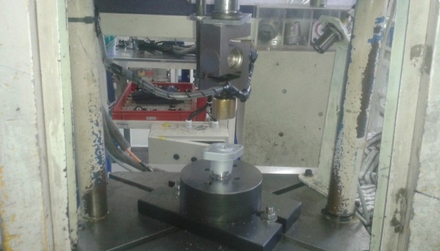
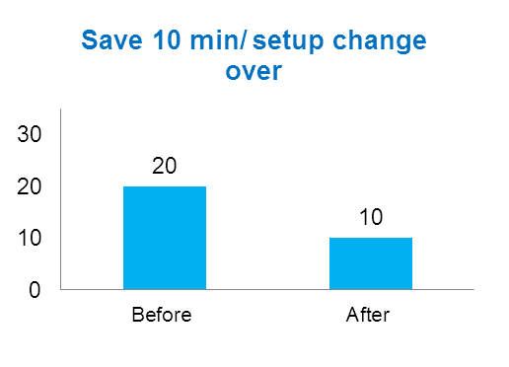
P15
TPM CIRCLE NO :- 01
ACTIVITY
KK
QM
PM
JH
SHE
OT
DM
E&T
KAIZEN IDEA SHEET
TPM CIRCLE NAME: Achiever
LOSS NO. / STEP
DEPT :- PLANT ME
RESULT AREA
M
Q
A
B
C
D
S
M
CELL:- Tensioner
CELL NAME:- A157
MACHINE / STAGE :- Plug Pressing Assembly
OPERATION :- Body Plug Pressing
KAIZEN THEME : To reduce the setup change over cycle time
IDEA :- Provide quick change attachment at press base & change height vernation fixture
COUNTERMEASURE:- Quick change attachment at bottom plate & equal the height of each fixture.
BENCHMARK
20 min.
PROBLEM PRESENT STATUS :- Every setup change over time 20 min. required.
TARGET
10 min.
KAIZEN START
10.04.2017
TDC
25.04.2017
KAIZEN FINISH
23.04.2017
TEAM MEMBERS : Ganesh Gaikwad , Nitin
Sutar
BENEFITS :-
P:- Increase the productivity 300 nos./day
M:- Increase the operator moral
Before
After
WHY1 :- Every setup change 20 min. required.
Why 2:- Each model fixture not common change height no quick change attachment.
Why3 :- Fixture height change & provide quick change attachment at fix base plate
RESULT :- Save the 10 min./setup change over
KAIZEN SUSTENANCE
WHAT TO DO:- Check point added in Sustenance audit check sheet . .
HOW TO DO:- Check visually.
FREQUENCY :- Alternate day
ROOT CAUSE : Each Fixture height not same & No quick change attachment at press base.
SCOPE & PLAN FOR HORIZONTAL DEPLOYMENT
Sr No | CELL | TDC | RESP. | STATUS
1 | A319, A216 | 25.06.2107 | Nitin Sutar | In process
REGISTRATION NO. & DATE : 10.04.2017
REGISTERED BY :-Nitin Sutar
MANAGER’S SIGN :- Ganesh Gaiwad

